Slide 1
Information security and verification
Created and presented by:
Prateek Purohit
CSE(E)
40996302717

Slide 2
What is Information security and verification?
Information security and verification is a employee management system with extra security like database users and admin. An employee will be verified before he or she can enter the premises or the office building.
The security part is that data can only be accessed by security personals having a certain username and password.

Slide 3
Why Information security and verification?
Easy to use
Efficient
Portable
No need for registers
Backup is easy and fast
Easy to maintain

Slide 4
Languages and tools
Languages used:
Python
MySQL
Tools Used:
Visual Studio Code
Qt Designer
Command Prompt

Slide 5
Working of the application
If admin , then the user have access to all features like Manage Users and manage Employees
User enters the credentials on the login page of the application
The credentials are verified by database security
Else the user can only access the employees data provided the read or write access.

Slide 6
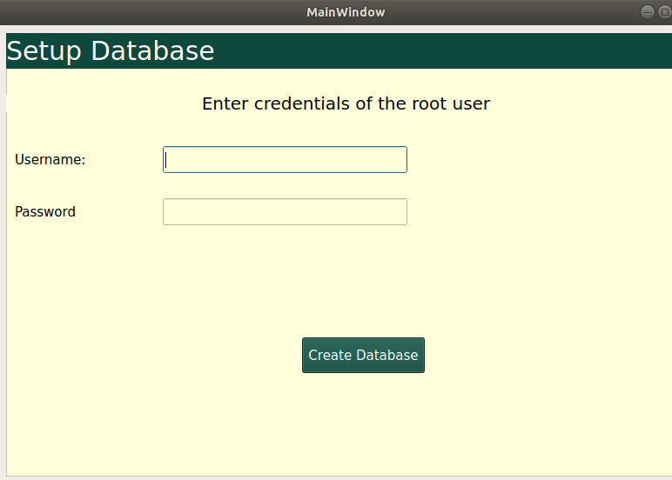
The setup
To create new database for the application the credentials of the root users are required.
Create database creates a new database for the application

Slide 7
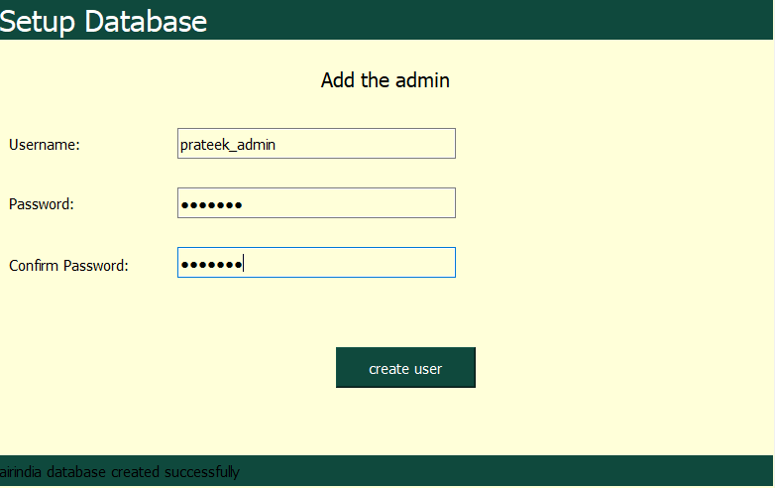
The setup (continued)
Admin Credentials for the application
After database creation , a new admin for the application is created.

Slide 8
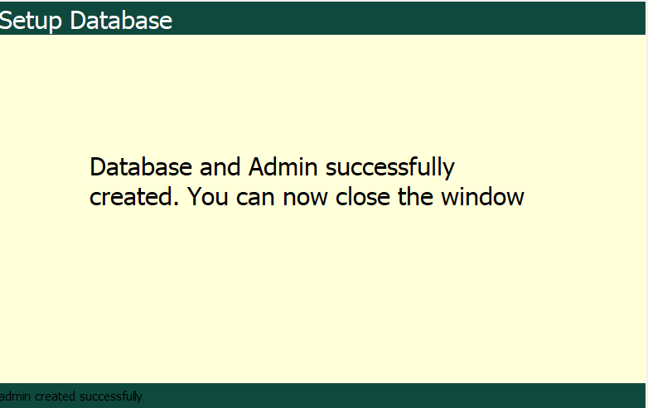
Setup (continued)
Once the database is successfully created a success window pops up.

Slide 9
THE APPLICATION

Slide 10
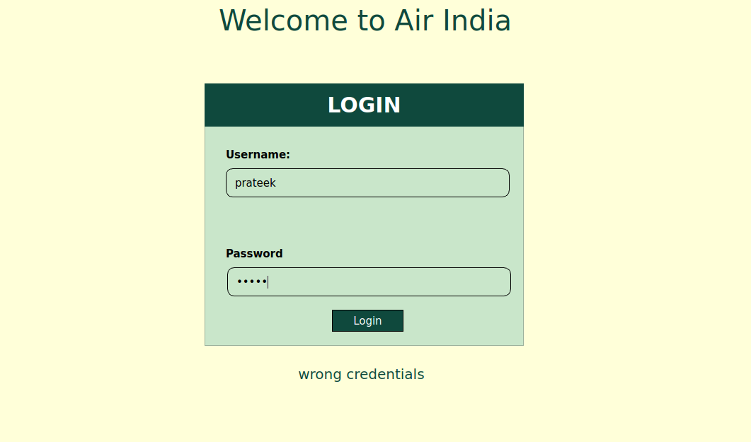
Login window
The login credentials are entered and verified
Once the login is verified , the page is redirected to option window
Status bar

Slide 11
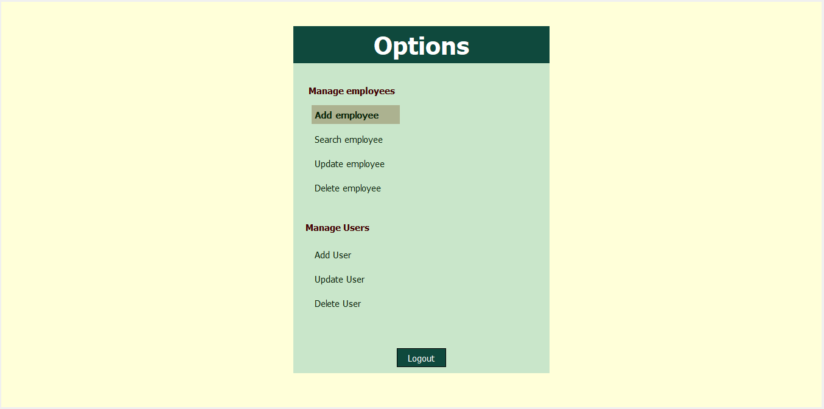
Option window
The option window consist of two parts.
Manage Users: can be accessed only by admin
Manage Employees: can be accessed by both user and admin

Slide 12
Option window (Manage Employees)
To search an employee
To add a new employee
To update an employee
To delete information about an employee

Slide 13
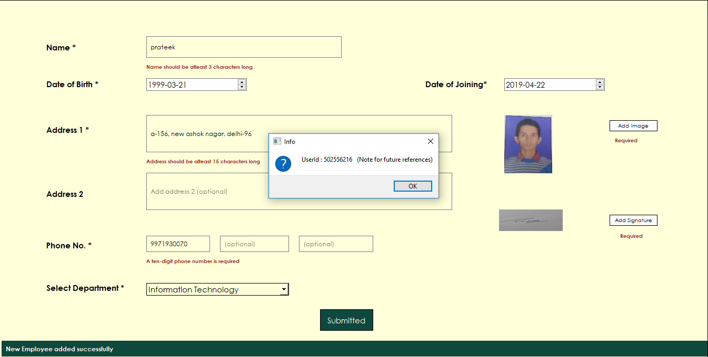
Add Employee
The add employee consist of the following information.
Name
Date of birth
Date of joining
Address 1
Address 2
Phone numbers
Photograph
Signature
Department

Slide 14
Add Employee (continued)
Once the information is successfully submitted, a unique id is generated which will identify the user.

Slide 15
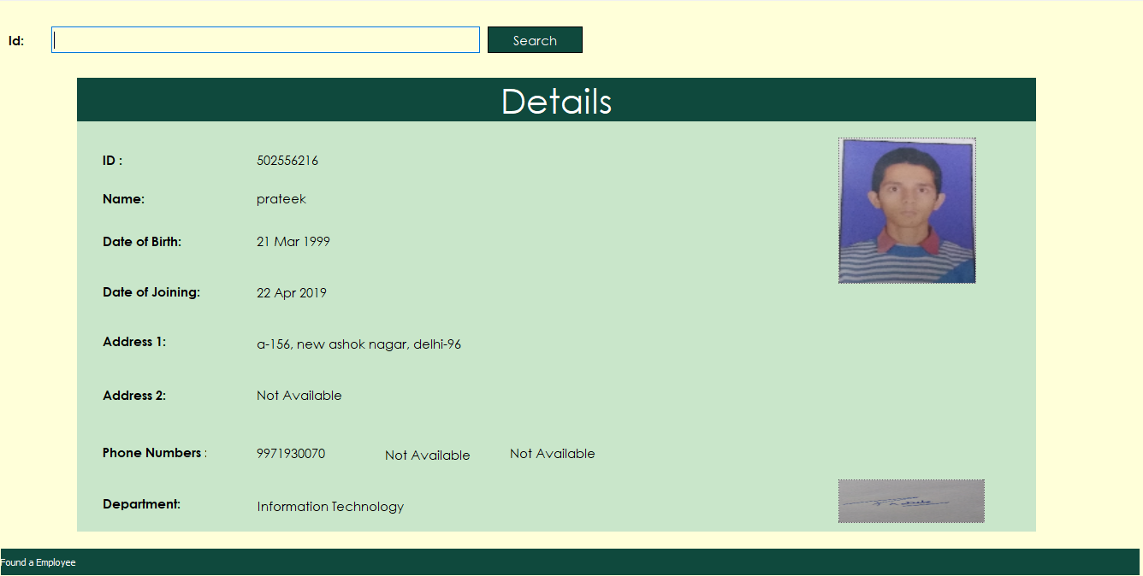
Search employee
The employee unique id is used to search and verify the details.
Photo and signature
The details of the employee are shown as soon as the id is found.

Slide 16
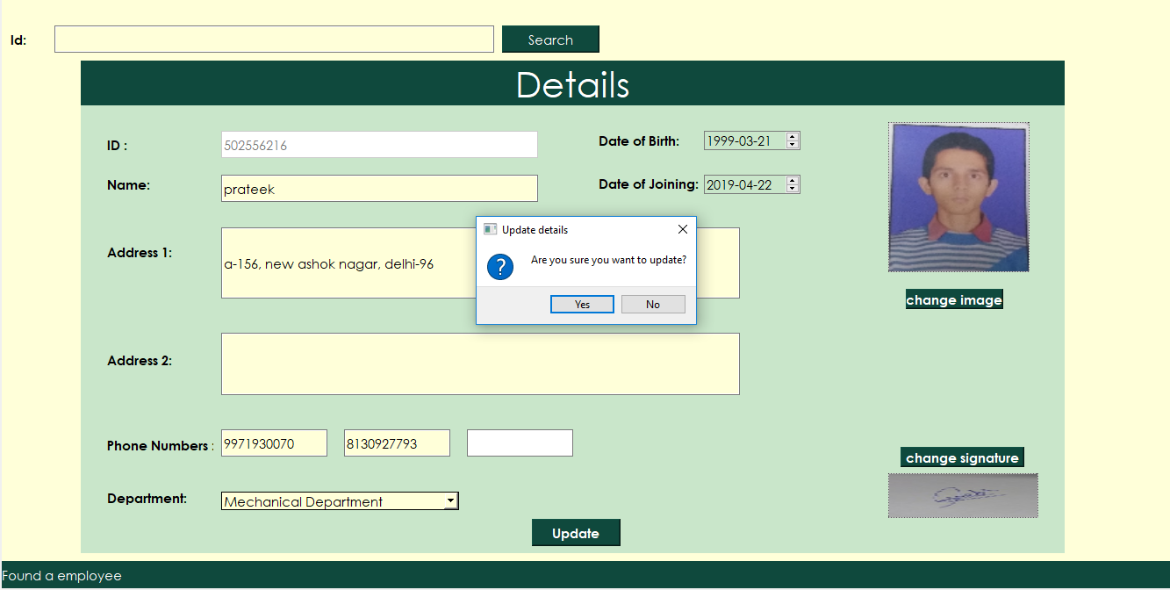
Update employee
The id of the user whose information needs to be updated is entered
Confirmation box.
Once you click the update box and no validation errors occur , a confirmation box will appear

Slide 17
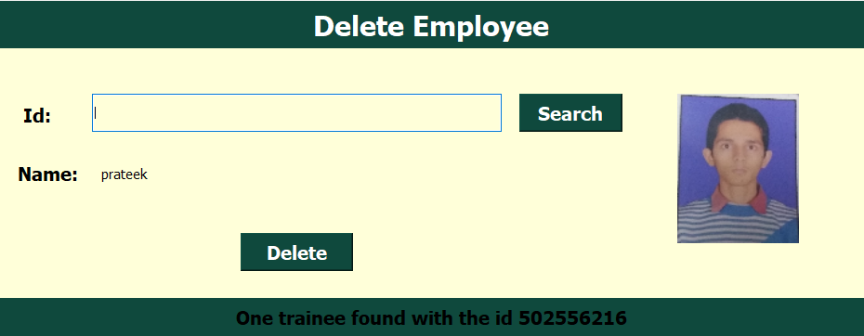
Delete Employee
Once the user with the certain id is found it can be deleted..
Information of the user
Status bar

Slide 18
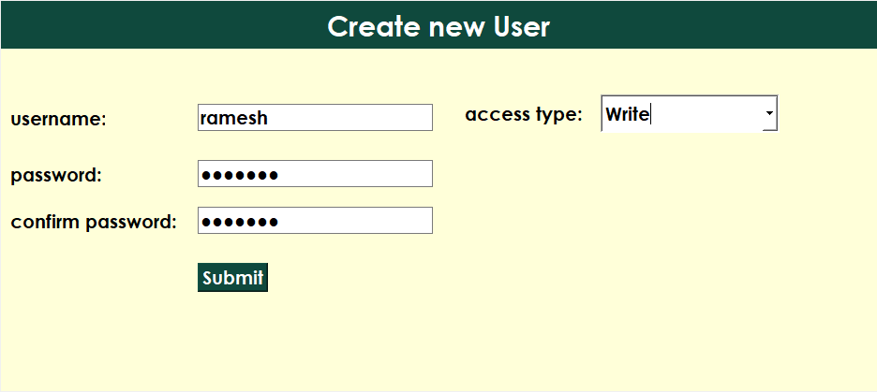
Add User window
User credentials
Access type (read or write)
Once the user credentials are validated and the user does not already exist, a new user is created.

Slide 19
Option window (Manage Users)
Manage Users can only be accessed by the admin of the application
To add a new user for the database
To update the user’s right (read or write)
To delete the user
To logout from the current session or user

Slide 20
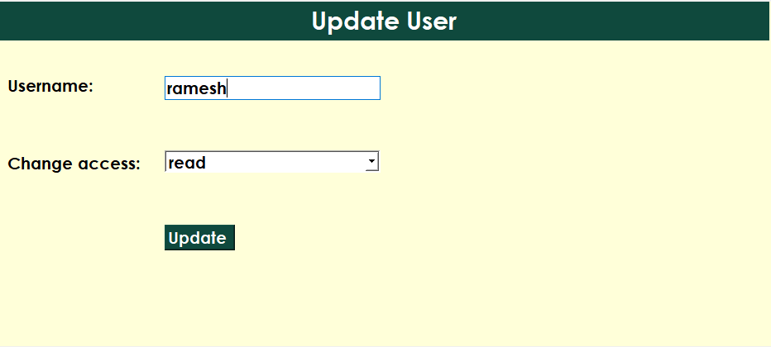
Update User Window
Update User
Once the user is found, its access type can be updated.

Slide 21
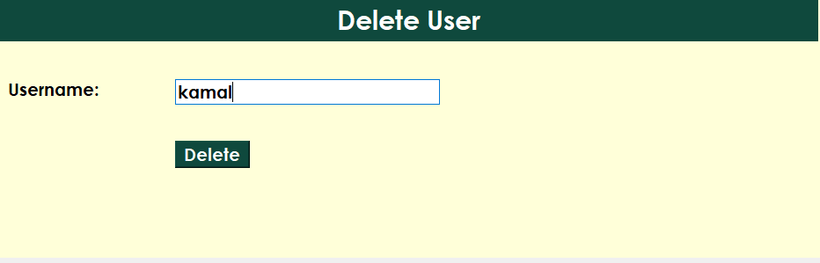
Delete User Window
Delete User
In order to delete a user only username is required.
Once the username is found, the user can be deleted.

Slide 22
THANK YOU

